Slide 1


Home credit
Machine learning Algorithms and Data analysis
-Rohan Mandhanya

Slide 2
Introduction
Problem- Home Credit Dataset
Data
Machine learning
Kaggle Competition

Slide 3
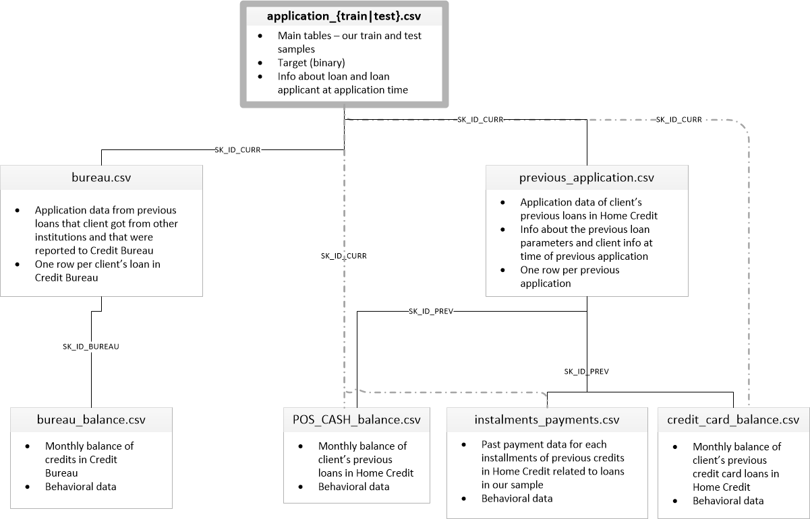
Data analysis
Data

Slide 4
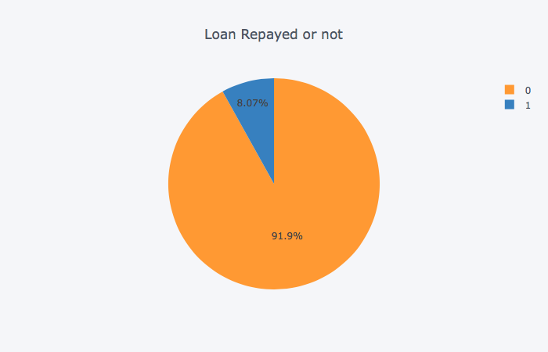
Biased data

Slide 5
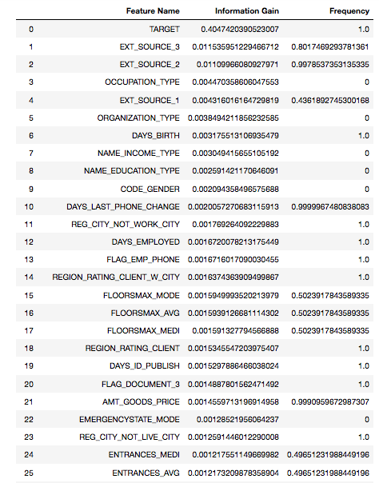
Information gain
Top 25 Features of Application Train
Using Information Gain for feature engineering.

Slide 6
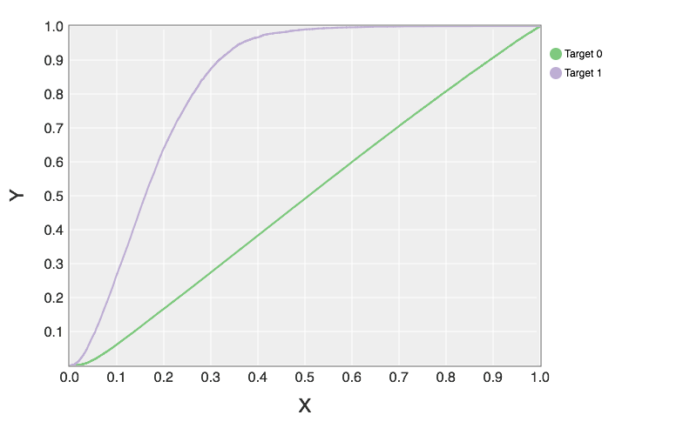
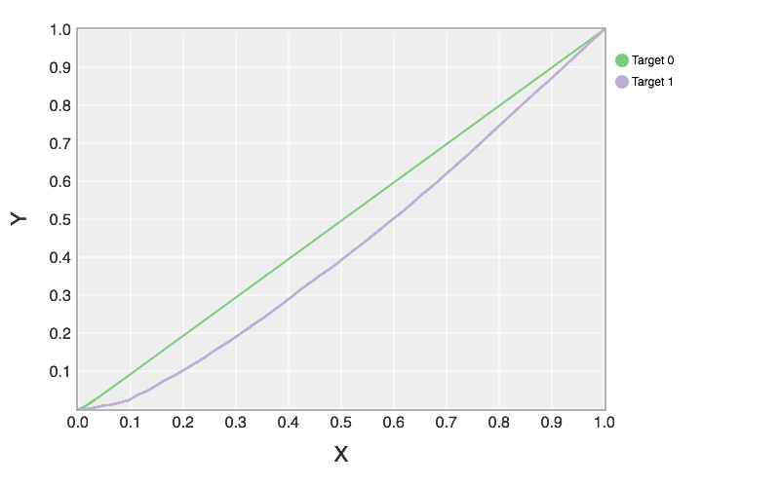
ECDF of normal Features
ECDF of AMT_CREDIT
ECDF of DAYS_BIRTH

Slide 7
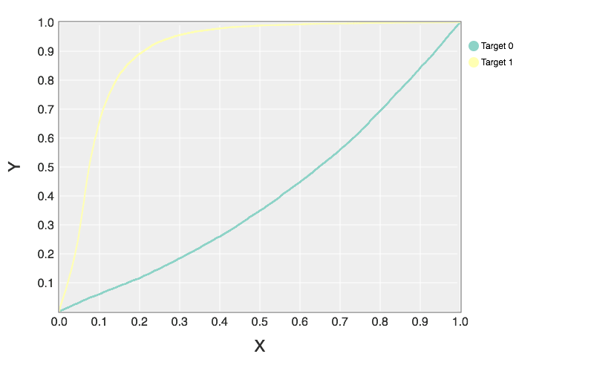
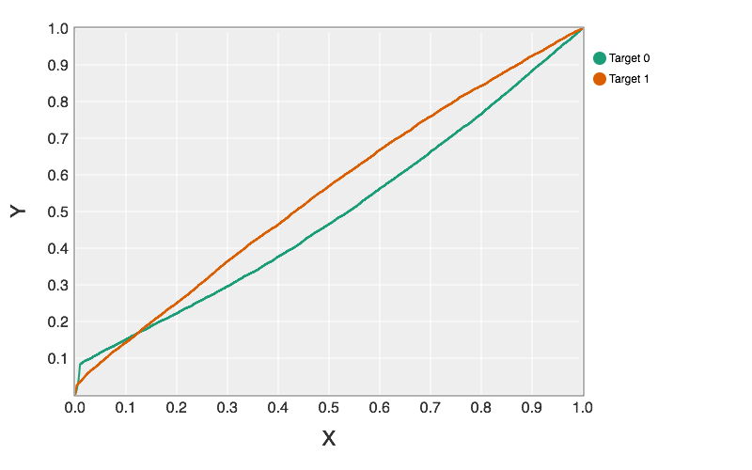
ECDF with Polynomial Features
ECDF of EXT_SOURCE_2/EXT_SOURCE_1
ECDF of EXT_SOURCE_2*EXT_SOURCE_3

Slide 8
Data Analysis
Algorithms
Transfer Learning on Logistic Regression
Random Forest
Analysis
ROC AUC

Slide 9
Experiment and Discussion
Experiment Methodology
Transfer learning
Feature Engineering
Evaluation Criteria
ROC AUC

Slide 10
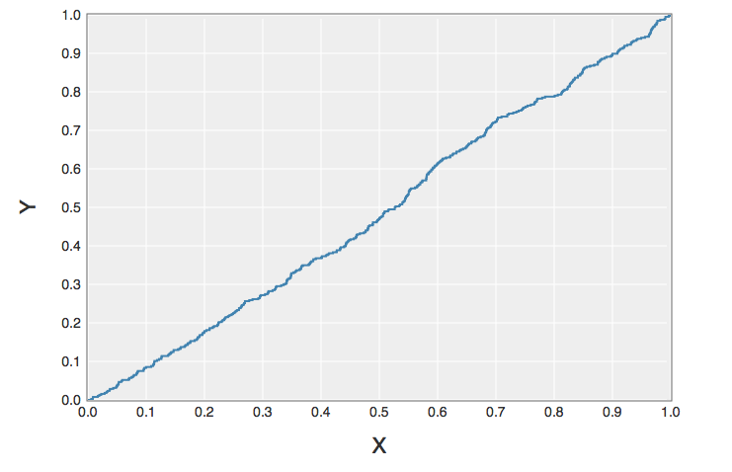
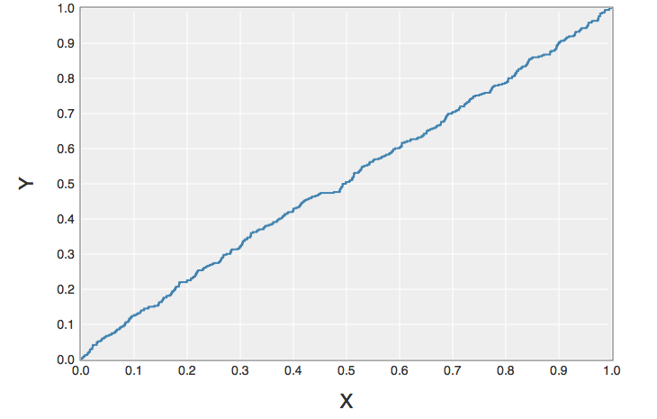
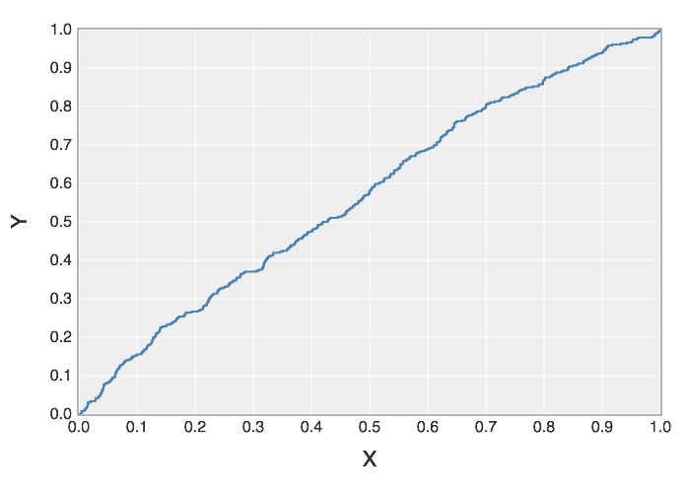
Comparison of ROC of Random Classifier, Logistic Regression and Transfer Learning Logistic Regression

Slide 11
Experiment and Discussion - CTs
Experimental Evaluation
Logistic Regression with EXT_SOURCE_*
Naive Bayes
Random Classifier
Fixed Classifier

Slide 12
Experiment and Discussion - CTs
Additional Experiments
Trying different Polynomial Features
Try different Transfer Learning Features

Slide 13
Conclusion
Findings
Faster Model
Accurate Model
Future Experiment
Selection Polynomial Features for better Transfer learning

